Slide 1
HW5-1 Text Style Transfer
TA 張致強 蔡翔陞 鍾起鳴

Slide 2
5.1.1 Style-Transformer

Slide 3
Text Style Transfer
amazing food , great service .
System
overpriced food , terrible service .
neg

Slide 4
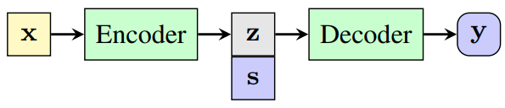
Typical Unsupervised Approach
Disentangle content and style in the latent space.
A discriminator is used to make sure z is style independent.
x
Encoder
z
Decoder
y
s
Discriminator

Slide 5
Style Transformer: Unpaired Text Style Transfer without Disentangled Latent Representation
Ning Dai, Jianze Liang, Xipeng Qiu∗ , Xuanjing Huang
Fudan University
Notes:
ACL 2019

Slide 6
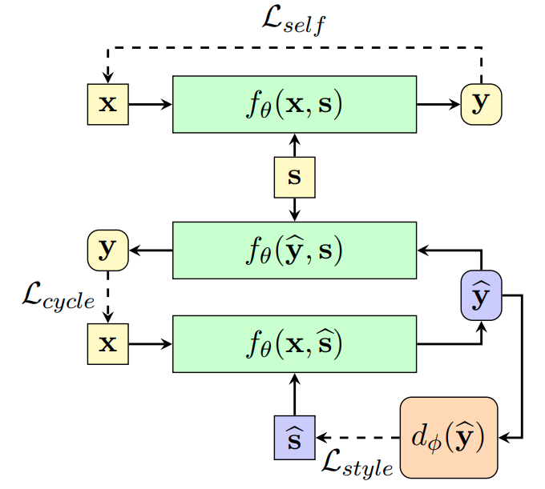
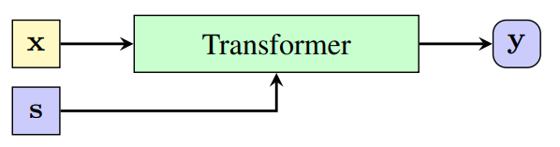
Approach
No disentanglement
No compressed representation

Slide 7
GAN!
Notes:
Text GAN 一般難train 但有其他Loss輔助 這個work很穩定

Slide 8



Training Style-Transformer
Self Reconstruction
you found an easter egg!!!!
Cycle Reconstruction
___
Style Controlling
Notes:
實作裡有pretraining也是做這個部分

Slide 9
Training Style-Transformer
Self Reconstruction
you found an easter egg!!!!
Cycle Reconstruction
___
Style Controlling

Slide 10
Training Style-Transformer
Self Reconstruction
you found an easter egg!!!!
Cycle Reconstruction
___
Style Controlling
Notes:
目的是希望保留內容 防止Generator為了衝高transfer的accuracy 而丟棄內容資訊

Slide 11



Training the Discriminator (Conditional)
y
Real Dataset
s
Real (1)
Real (1)
Discriminator
0/1
Fake (0)
Notes:
吃句子跟Label 吐出01

Slide 12
Training the Discriminator (Multiclass)
y
Real Dataset
s
Real (class s)
Real (class s)
Discriminator
0
...
K
Fake (class 0)
Notes:
吃句子吐出class

Slide 13
Evaluating Text Style Transfer System
Accuracy: Classification accuracy of transferred sentence.
BLEU: Content preservation.
self-BLEU: score by source sentence
ref-BLEU: score by reference (target) sentence
Perplexity: Sentence fluency.
Human Evaluation

Slide 14
5.1.2 Tasks

Slide 15
Code
Github - https://github.com/MarvinChung/HW5-TextStyleTransfer
See README.md for instructions to run.
Notes:
README 有一個檔案要載 一定要看 不然會噴Err

Slide 16
Configurations
You can (should) tune some of the following args to obtain better results.

Slide 17
Model related
argument | description
discriminator_method | Two types of discriminator described in paper.
embed_size, d_model, head, num_layers | Transformer architecture.
learned_pos_embed | Use trainable position encoding or sinusoidal.
Notes:
Internally d_ff is hard coded to 4*d_model, beware of that.

Slide 18
Training related
argument | description
batch_size, lr_F, lr_D | Typical training hyperparameters.
L2, dropout, inp_drop_prob | Various regularizations.
iter_D, iter_F, F_pretrain_iter | Affects relative strengths of style-transformer and discriminator while training.
slf_factor, cyc_factor, adv_factor | Weight factors of three loss described in paper.

Slide 19
What you should do
Understand and train a Text Style Transfer model
Show your training configuration
show what's different from default
Show your training curves
Plot the three loss in style-transformer
Plot the discriminator loss
Evaluate your model
Report your best model’s accuracy, ref-BLEU and perplexity
Submit your model’s output on the 1000 yelp testing data
Show some results on sentences inside or outside of the yelp dataset
Notes:
1000 yelp: 500 neg 500 pos (see test.py)
Outside dataset 是希望大家測看看自己的model在別的testing data上的轉換表現是不是也很好

Slide 20
5.1.3 Sample Report

Slide 21
HW5-1
B05902064 張致強

Slide 22
Configuration
We use the sinusoidal positional embedding. Also changed batch size to 128. Other settings follows the default.

Slide 23
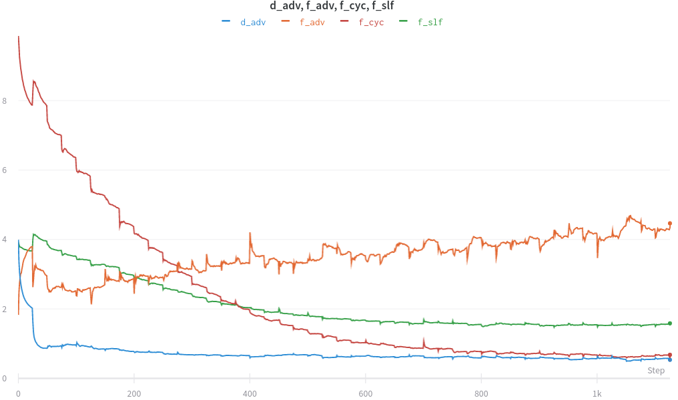
Loss
d_adv | discriminator loss
f_adv | style controlling loss
f_cyc | cycle consistency loss
f_slf | self reconstruction loss

Slide 24
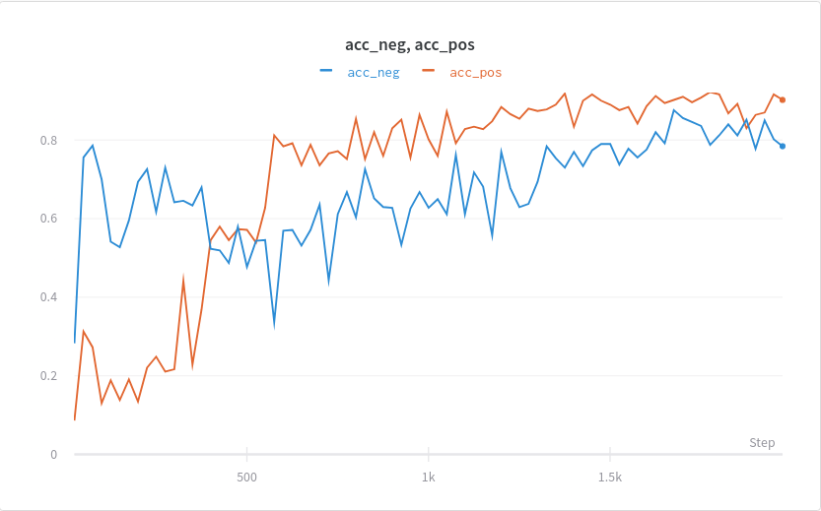
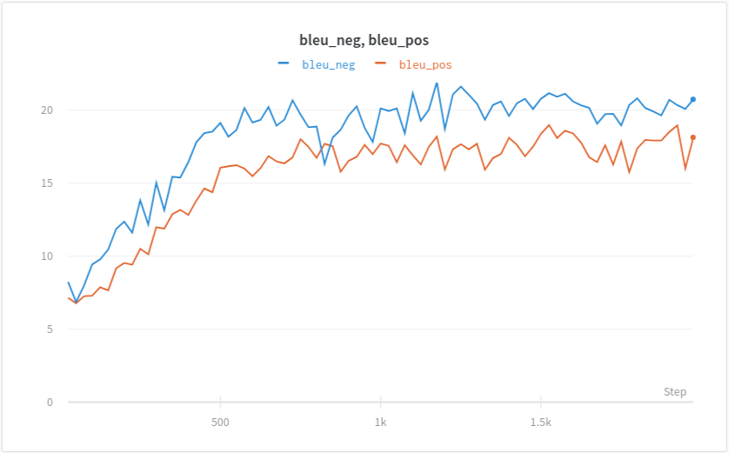
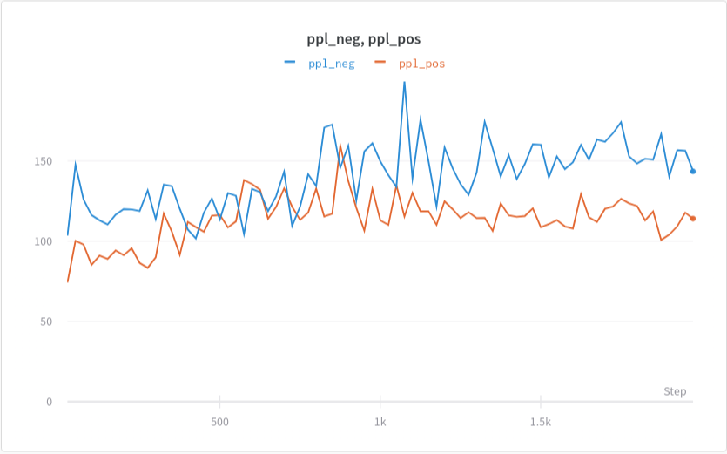
Evaluation - Metrics
 | pos | neg | avg
accuracy | 0.902 | 0.784 | 0.843
ref-bleu | 18.132 | 20.734 | 19.433
perplexity | 114.031 | 143.505 | 128.768
Notes:
你要秀出plot或是terminal output. (不可以自己編數字！)

Slide 25



Evaluation - Good Examples
Notes:
（6/16）更：正反例子都請放上至少兩個

Slide 26


Evaluation - Problematic Examples
food would be disgusting, and person disgusted.
beyond hungry means very+++ hungry

Slide 27
Observation (optional)
Despite being a text GAN, the training process is surprisingly stable using this set of hyperparameters.
Our model seems to perform better on pos->neg transfer.

Slide 28
5.1.4 Human Evaluation

Slide 29
Procedure
Each team will submit their outputs on testset (submission.txt)
After the due date June 24, TA will announce the 10 sentences to be evaluated.
Each team will review 2 other teams' output, totaling 20 reviews
Peer review form will due on June 30 (23:59), no late submission
You can get 0.5% just by reviewing others !
Notes:
human請一組填一次即可

Slide 30
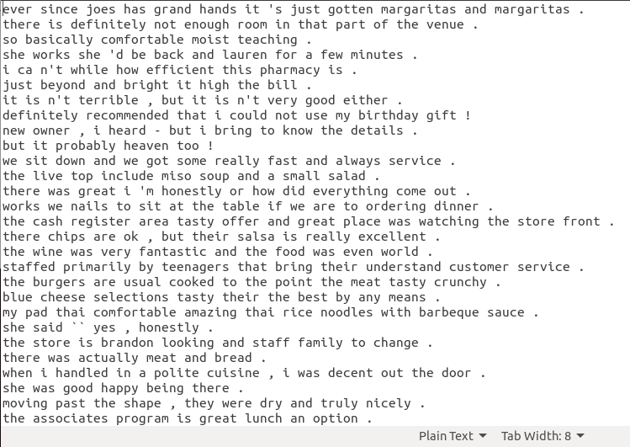
submission.txt
Generate style transferred sentences on the provided yelp test set (1000 sentences), in the same order as the test set.
Do not change the order of the output sentences! TA will not order for you, sorry QQ.

Slide 31
5.1.5 Submission & Grading

Slide 32
Submission
Github (DLHLP2020-SPRING/hw5/)
report.pdf
submission.txt
Notes:
report請5-1, 5-2, 5-3放同一檔案即可

Slide 33
Grading
Report (4%)
show configuration (1%)
show loss plot (1%)
show metrics (1%)
show examples & comment on them (1%)
Results (2% + 1% bonus)
Your auto-metrics are as good or better than baseline (1%)
Accuracy and BLEU: the higher the better.
Perplexity: the lower the better.
within ±5% is considered “as good”.
You submitted submission.txt that is intact (1%)
Human evaluation
you reviewed others' results (0.5%)
your quality is in top 10% of class (0.5%)
baseline | (pos+neg)/2
accuracy | 0.7
ref-bleu | 17
perplexity | 150
Notes:
human請一組填一次即可

Slide 34
Q&A

